Slide 1
Learn It Yourself
Lernziele spieleriesch selbst erreichen
Jonas hilpp, angelika sudheimer, mert gündüz, jannik adam

Slide 2
Agenda
Business
Quality
Technical Ability

Slide 3
Business
Vision
Scope //UC
PM // AGILE RUp
FP

Slide 4
Our Vision
Blow up your motivation levels for reaching your goals!
Turn mundane tasks such as studying into a game!

Slide 5
Vision - Mission
You can create your own mission
Consists of tasks
Definition of a „Mission“ is up to you!!
Notes:
it does not necessarily have to be about studying
Mit linker Hand Zeugs erledigen
Statur behalten
<Foliennummer>

Slide 6
Vision - Motivation
Competitive
Self-reflection
Points for completing tasks
Highscore system
Group statistics
Push notification
Individual rating of (completed) tasks
Reward system outside groups
Spend points on personal rewards
Notes:
Highscore system to help you compare yourself with others and track your own improvements.
Statistics provide who is first and who is last.
Push notifications if you’re last to make sure you step up your game.
reflect upon him/herself by giving an individual rating after finishing a task. This way you will keep track on the parts you have mastered well, but also areas where you still could need some polishing.
You’ll be able to individualize the amount of points rewarded for each task. In addition to this, you can define your own personal rewards, such as eating a Snickers.
<Foliennummer>

Slide 7
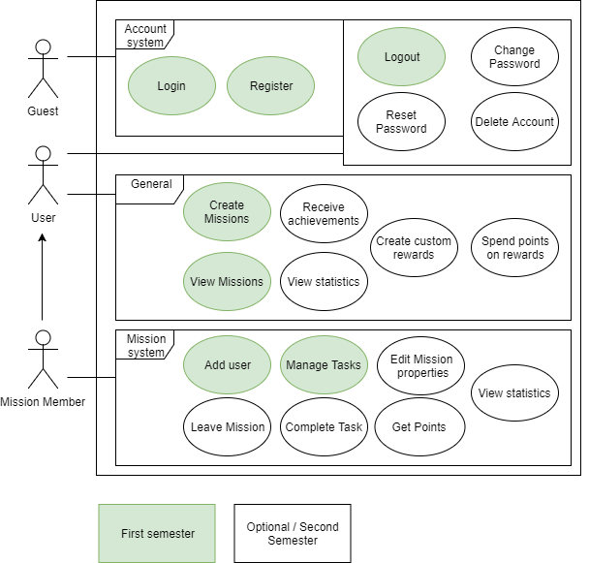
Scope: Use-Case Diagram
Account system ☺
Create/View Mission
Add user
Manage Tasks
Gamification coming next semester!

Slide 8
Project management
SCRUMMING with YouTrack
Dont assume that the people you present to know what scrum is.
So you can explain why you pick this method and how it affects the client.

Slide 9
SRS

Slide 10
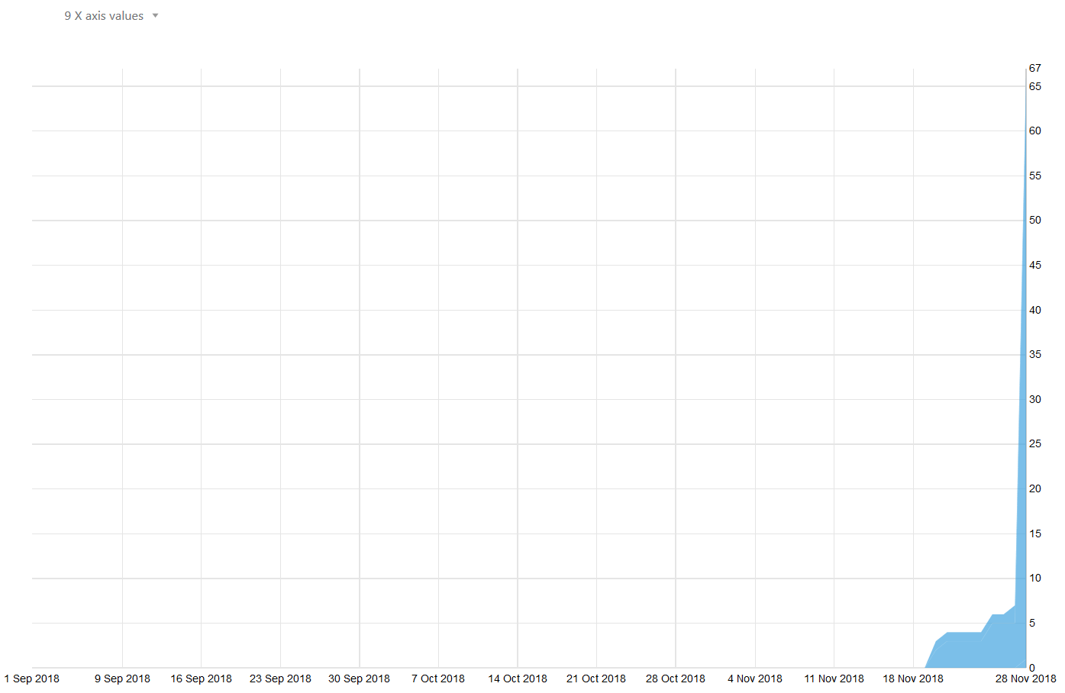
RUP
Notes:
Wie sie sehen können, sehen sie nichts -> Fehler eingestehen, im Final wird es besser aussehen
<Foliennummer>

Slide 11
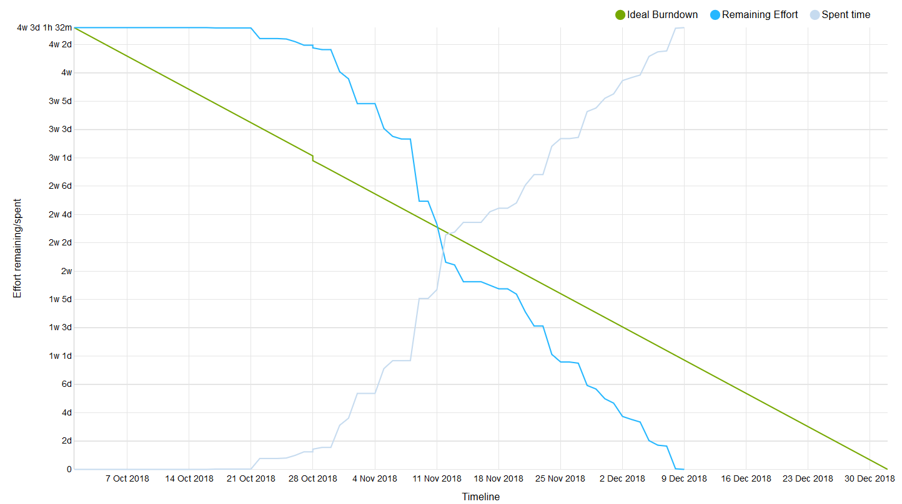
Burndown

Slide 12
Quality
Workflow// Git, Youtrack, Sonar...
Config
Testing
Automation
Architecture
Patterns
Metrics

Slide 13
Configuration

Slide 14


Testing
Unit Testing
Functional Testing
Testing the functionality of individual functions
Testing a complete functionality of the application
User Testing
Testing the usability

Slide 15






Continuous Integration
Development
Version Control
Continuous Integration
Trigger
Build and Test
Feedback

Slide 16
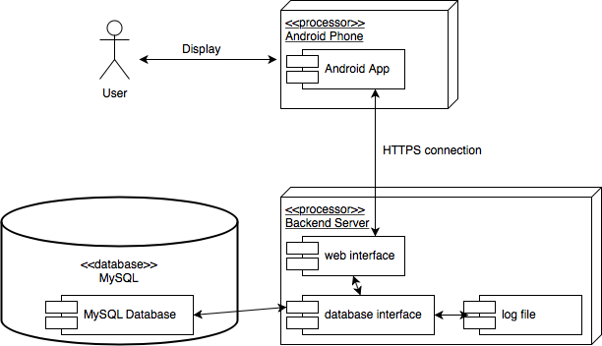
Architecture

Slide 17
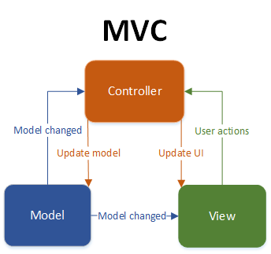
Architecture II

Slide 18
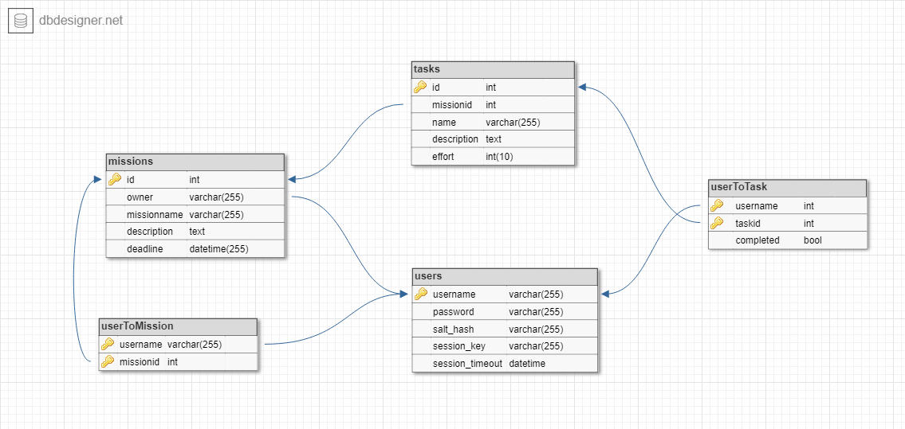
Architecture III

Slide 19
Configuration
No clue

Slide 20
Automation
Tests, DIE, git, YouTrack SHOW Integration
Automated testing is important, why is it important. Are you mentioning that in your talk, are you explaining how it is integrated into your project. what does this mean for the client? Present proof that yours are executed. So - not only are you implementing it technically, but you are also arguing in your presentation how it is integrated into your project management and software engineering process and methodology of running your project. You dont need to mention it 4 times, but for me I need to see whether you cover all aspects of the testing during your talk.

Slide 21
Technology
Class diagram
Technical Ability
live demo

Slide 22
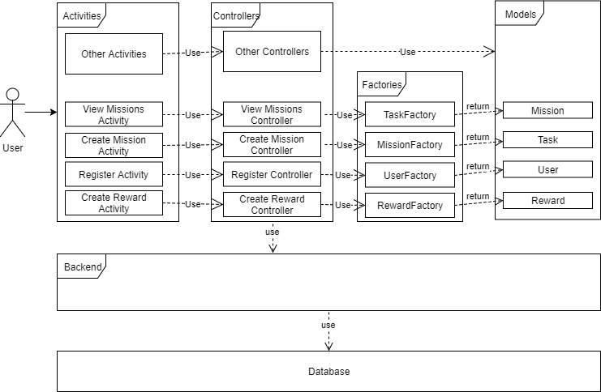

Slide 23
Technical Ability
Account
CRUD Missions
CRUD Tasks
CRUD Rewards
Statistics
Achievements

Slide 24
Demo

